Slide 1
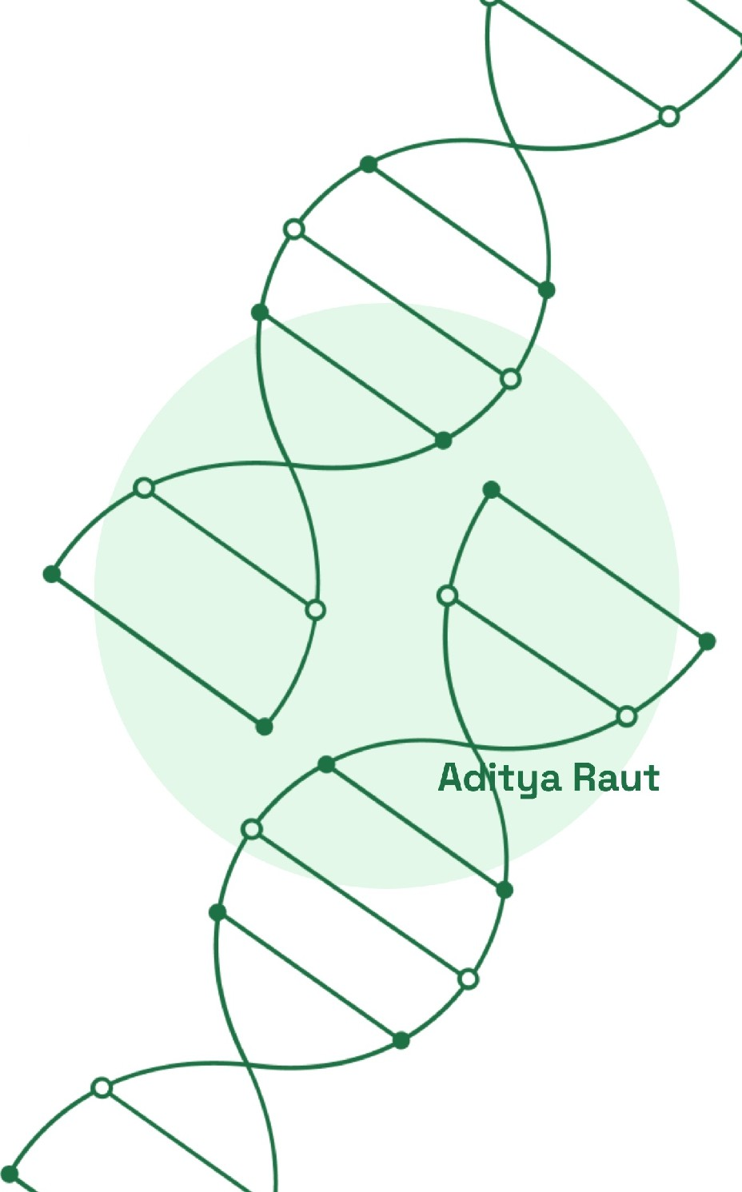
Fine Tuning A Model Locally
A Comprehensive Analysis of LLMs, Their Architecture, and the DistilBERT Model in NLP Applications

Slide 2

Overview of Large Language Models (LLMs)
LANGUAGE MODELS
Understanding the Impact and Functionality of LLMs in Natural Language Processing
Definition of LLMs
Large Language Models (LLMs) are advanced Al systems engineered to comprehend and generate text that mimics human language.
Notable Examples
Prominent LLMs include GPT, BERT, and DistilBERT, each with unique architectures and capabilities.
Contextual Understanding
LLMs excel in contextual understanding, allowing them to grasp nuances in language and meaning.
Adaptability to Tasks
These models can adapt to various tasks, such as translation, summarization, and classification, showcasing their versatility.
Significance in NLP
LLMs are instrumental in advancing natural language processing, pushing the limits of what Al can achieve in language tasks.

Slide 3

DISTILBERT OVERVIEW
Overview of DistilBERT
Key Features and Performance
■
Streamlined Version of BERT
DistilBERT is developed to be a more efficient alternative to the original BERT model, aimed at improving computational resource management.
Faster Training
II Training time is significantly improved, with DistilBERT being 60%
faster than BERT, allowing for quicker deployment and iteration.
High Accuracy
DistilBERT achieves approximately 97% of BERT's accuracy, ensuring that users do not have to sacrifice performance for efficiency.
Retains BERT's Performance
Despite being lighter, DistilBERT maintains much of the effectiveness of BERT, making it a viable choice for many applications.
II
II
Resource-Efficient
Ideal for environments with limited computational resources, DistilBERT is particularly beneficial for developers and researchers with constraints on infrastructure.
Fewer Parameters
II With 40% fewer parameters than BERT, DistilBERT reduces model
complexity while still delivering strong results.
II

Slide 4
Understanding distilbert-base-uncased Model
Key Features and Applications of DistilBERT
DISTILBERT OVERVIEW
II
Model Type
The distilbert-base-uncased model is a specific variant of DistilBERT designed for English text processing without case sensitivity.
II
Versatile Applications
DistilBERT serves diverse applications including text classification and sentiment analysis, making it highly versatile in NLP.
II
Pre-trained Nature
This model is pre-trained on uncased English text, allowing it to quickly adapt to various natural language tasks without extensive retraining.
II
Quick Adaptability
Thanks to its pre-trained foundation, the model can be tailored for specific applications efficiently, reducing the time and resources needed for training.

Slide 5
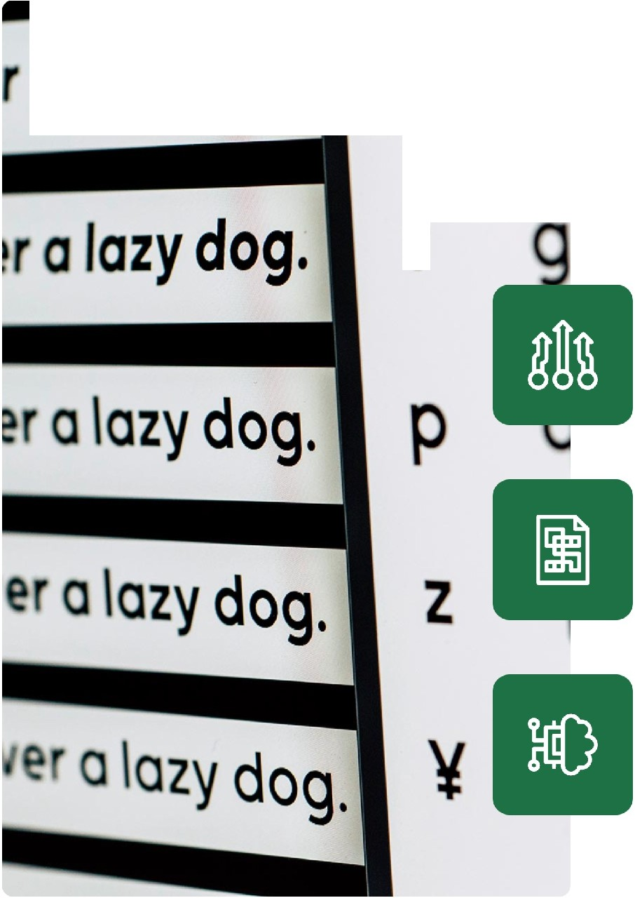

\
f
NLP APPLICATIONS
Applications of DistilBERT
Key Uses in Natural Language Processing
a lazy dog.
1 Sentiment Analysis
Analyzing text to determine the sentiment expressed, which is crucial for understanding customer feedback and identifying trends in consumer behavior.
2 Named Entity Recognition (NER)
Identifying and classifying entities in text into predefined categories such as names, organizations, and locations, enhancing data organization and retrieval.
3 Question Answering
Enabling systems to provide precise answers to questions posed in natural language, thus enhancing the interactivity and usability of Al applications.

Slide 6

Fine-Tuning the Distilbert-Base­ Uncased Model
MODEL FINE-TUNING
II
Dataset Preparation
This involves collecting and formatting the data that is pertinent to the specific
task at hand to ensure compatibility.
Key Steps in the Process
II
Modifying the Classification Head
The model's output layer is customized to meet the specific requirements of the task, enhancing its ability to classify accurately.
II
Training on Labeled Data
Utilizing a labeled dataset is vital to effectively train the model, refining its predictions to boost performance and accuracy
.

Slide 7
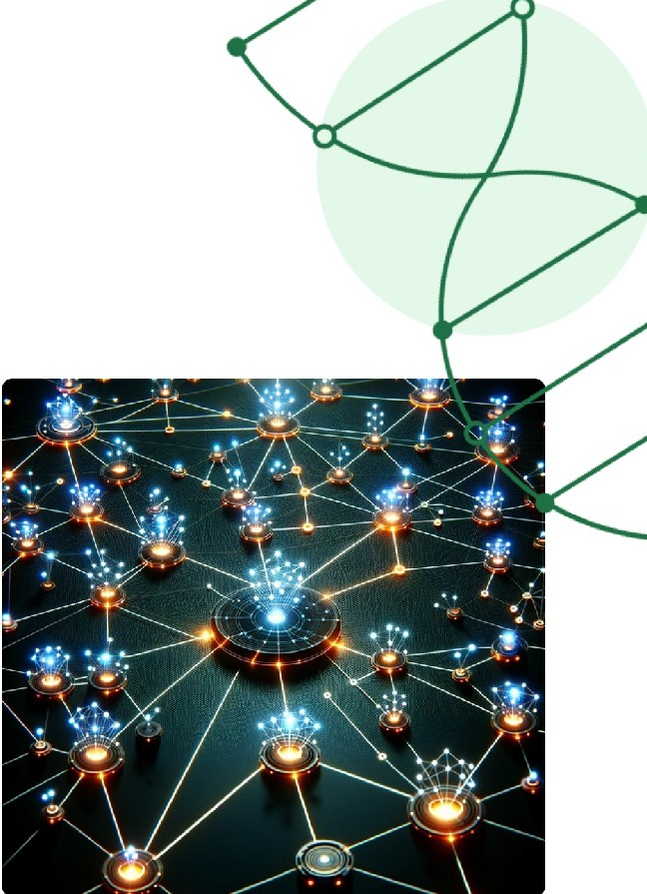
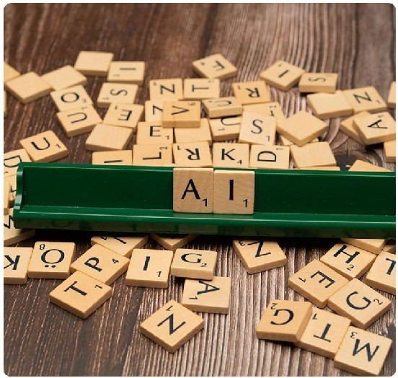


Conclusion on Large Language Models and Transformers
Understanding the Impact and Capabilities of DistilBERT in NLP
NLP ADVANCEMENTS
-
Transformative Nature of Large Language Models
Efficiency and Versatility of DistilBERT
Accessibility in Resource­ Limited Settings
Enhancing Complex NLP Task Capabilities
Large Language Models have fundamentally changed the landscape of natural language processing by creating robust tools that excel in understanding and generating human-like text.
DistilBERT stands out as an efficient model that reduces the resource requirements while maintaining high performance, showcasing significant advancements in model design.
With its reduced size and improved efficiency, DistilBERT makes state-of-the-art NLP techniques accessible even in environments with limited computational resources.
Leveraging the power of these models enables the execution of complex NLP tasks, enhancing applications in various fields such as sentiment analysis, translation, and more.

